Slide 1
CZECH – GERMAN YOUNG PROFESSIONAL PROGRAM
Solidarity, stability and security in post-factual times
Lucie Streitová, E.ON Czech

Slide 2
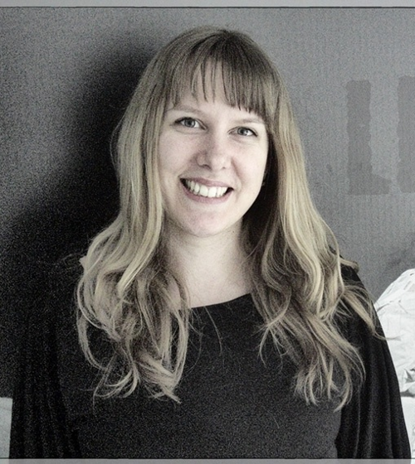
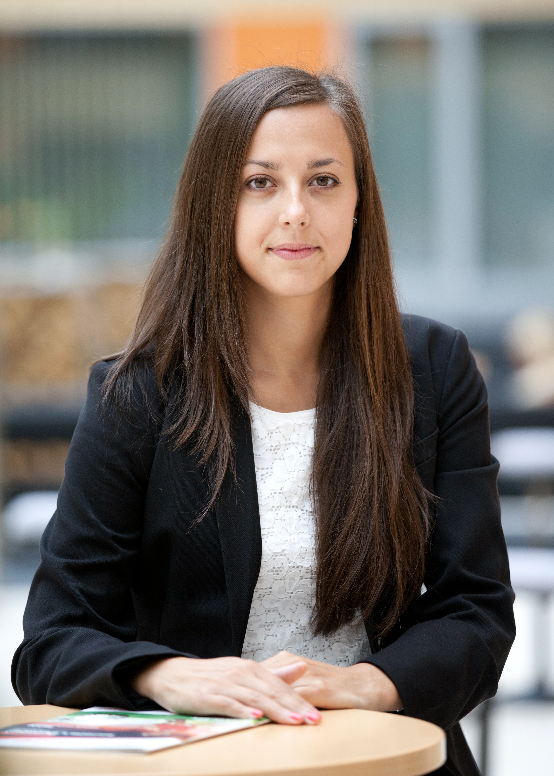
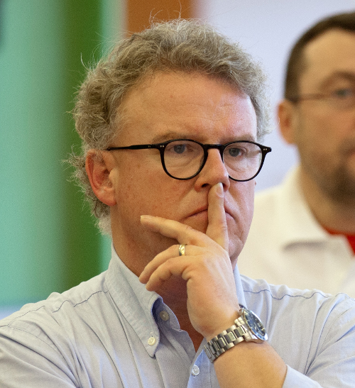
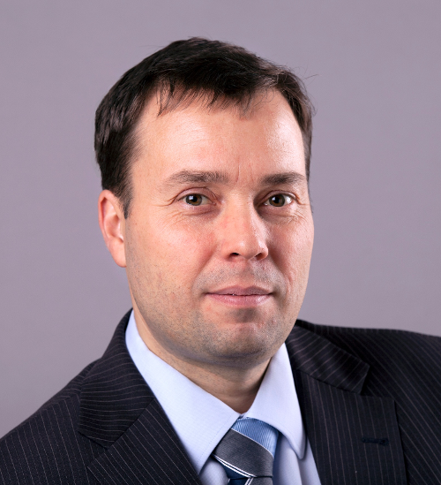
Topic: Security and cybersecurity in the present
Respondents
Lenka Pařízková – Regional economic and public administration
Erika Širůčková – Politology and political theory
Magnus Alexander Brandau – Communications and political affairs
Radek Bílý

Slide 3
Questions
What does the term of security mean for you?
What are the impacts of terrorism on our security?
What is the importance of cyber security in 21st century?

Slide 4
What does the term of security mean for you?
Freedom needs Security especially for the weak, that they can really exercise their freedom. Therefore security for me means a kind of feeling that includes also parts of stability regarding future developments. In concrete this means that I can refer to a framework which secures not only my material belongings but also my individual freedom as a human being and a citizen and the freedom to choose also - this is the future aspect - for my children.

Slide 5
Security has different meanings for every one of us I would say. The people do not distinguish between being secure and being safe. Is that a subjective feeling like being safe at home or in my country? Is that mainly about protection? Physical protection? Security has also several levels – personal, national, etc. The term is really very diverse and related to many or even to every area of our life. Military security, internet security, transportation security. It is omnipresent.
Me and my children can go without any fear to any place at any time.

Slide 6
What are the impacts of terrorism on our security?
instability
Two risks I see: First the direct attack harming our physical security and resulting consequences which could change our way we live and the second an overreaction from state institutions or society to harm our freedom as citizens by more and more observations and interventions which could lead to the same effect.

Slide 7
We should count with much more measures in our private life. For example highest control in the airport, often checks by polices or some other institutions etc. I think that’s necessary but the future is changing right now. We are in the beginning of new time. The borders of culture encounters.
First of all it is very difficult from the psychical point of view. People love stability, but the terrorism is a contrary of that, we never know what can happen and this is very stressful, frustrating. It is not possible to prevent us from terrorism for 100% , we know that the security is needed but on the other hand we do not like it? It is evident it produces a lot of anxiety and discomfort as well.

Slide 8
What is the importance of cyber security in 21st century?
Based on the fact that practically our whole infrastructure – public and private – depends on Digital, cyber security means concretely measures to protect it against criminal acts. Otherwise it means also, that my private Data can not be used without my will for purposes I do not want – public purposes included – see answer No two.

Slide 9
Living in a computer era is very difficult, many tasks seem to be simplified but with a very high risk on the other hand? The attacks via cyberspace are not visible and they are very efficient. Sometimes it is even very easy to harm as many people ignore security settings.

Slide 10
Thank you for your attention!

